Slide 1


Building a Continuous Social Media Data Collection System
iDRAMA.cloud
iDRAMA Lab
Established 2016
Jeremy Blackburn
https://mrjimmyblack.com / https://idrama.science
@mrjimmyblack.com on Bluesky

Slide 2
Who am I?
Jeremy Blackburn
Associate Professor at Binghamton University
iDRAMA Lab (https://idrama.science)
We work in the (very) broad area of understanding assholes online
Collect tons of datasets
4chan
Reddit
Gab
Parler
Gettr
Telegram
…
Before I got my undergrad degree, I was professional programmer
I love to program and still write 10k+ lines of code each year

Slide 3
What is this tutorial?
Social media data is heavily used by research
Social media platforms locking down data
E.g., Reddit recently changed policy
E.g., Twitter is totally gone ⚰️🪦
Data collection is hard
Especially when it’s ephemeral!
We need a toolkit to build continuous data collection systems
Strategies and tactics
Tools and tips
Code: https://github.com/idramalab/asonam-tutorial-2023/

Slide 4
What isn’t this tutorial?
It’s not a programming tutorial
Assumes some Python knowledge
It’s not an operating systems tutorial
Assumes some degree of systems knowledge
Assumes some comfort with command line
It’s not a databases tutorial
Assumes some understanding/knowledge of database systems
…

Slide 5
What’s the status chicos?
Big time changes in the past 12 months
Reddit
https://support.reddithelp.com/hc/en-us/articles/16160319875092-Reddit-Data-API-Wiki
Twitter
Gone (if you care about ToS)
Mastodon
Bluesky

Slide 6
How do we design a data collection system?
We want to build a data collection system
Not something one off or ad-hoc!
We are professionals
Or at least we try to be!
We want something robust
We need abstractions and a methodology
Something reusable!

Slide 7
Mapping a platform
Before we collect, we need to understand how a platform works
How to start?
Google for an API!
Doesn’t always work
It’s working increasingly less often
But… it’s the Web
If it’s out there, we can get it

Slide 8
Let’s Look at an Example: 4chan
But first, let’s see what 4chan’s all about for context…
4chan has an API
Makes our lives somewhat easier
4chan produces a decent amount of data
Long term, we will probably have to deal with storage issues
4chan is ephemeral
Makes our lives somewhat more difficult

Slide 9








Measuring 4chan’s Politically Incorrect Forum and Its Effects on the Web
Gabriel Emile Hine, Jeremiah Onaolapo, Emiliano De Cristofaro,
Nicolas Kourtellis, Ilias Leontiadis, Riginos Samaras,
Gianluca Stringhini, Jeremy Blackburn (@jhblackb)

Slide 11








Slide 12
What Exactly Is 4chan?
An image board
Conversations grouped into threads
Anonymous
No user accounts
Ephemeral
Dangerous?
Notes:
Say ”anon”

Slide 13
Basics
An “original poster” (OP) creates a new thread by making a post
Single image attached
Other users can reply
With or without images, and possibly add references to previous posts, quote text, etc.
NB: Quotations are implied by the > symbol, as users regularly use it to put words in other posters’ mouths
No likes, share, favorites, etc.
No validation from other users except more posts!

Slide 14
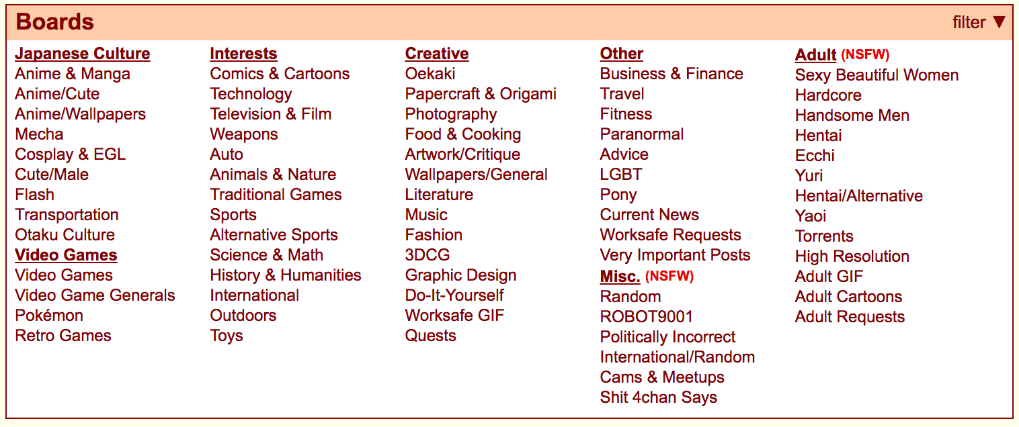
Boards
4chan separates conversation into different areas of interests known as “boards”
This paper focused on /pol/ (politically incorrect)
Also looked at /sp/ (sport) and and /int/ (international) for comparison

Slide 15
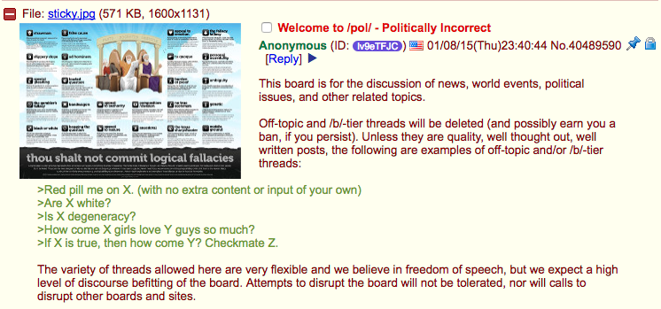
/pol/ - Politically Incorrect
Notes:
Pol was created as a containment board

Slide 16
/pol/ - Politically Incorrect
Extremely lax moderation
Volunteer “janitors” as well as ”admins”
Almost anything goes

Slide 17
The Bump System
Limit each board to N live threads
Threads ordered by MRU
A new post in a thread “bumps” it up to the top
Create a new thread → An old thread dies
Bump limit
Max of times thread can be bumped
Ensures that no discussion will dominate forever

Slide 18
The Bump System
Just crawling data is challenging!
We need to build a crawler that works with the ephemeral nature of 4chan
Limit each board to N live threads
Threads ordered by MRU
A new post in a thread “bumps” it up to the top
Create a new thread → An old thread dies
Bump limit
Max of times thread can be bumped
Ensures that no discussion will dominate forever

Slide 19
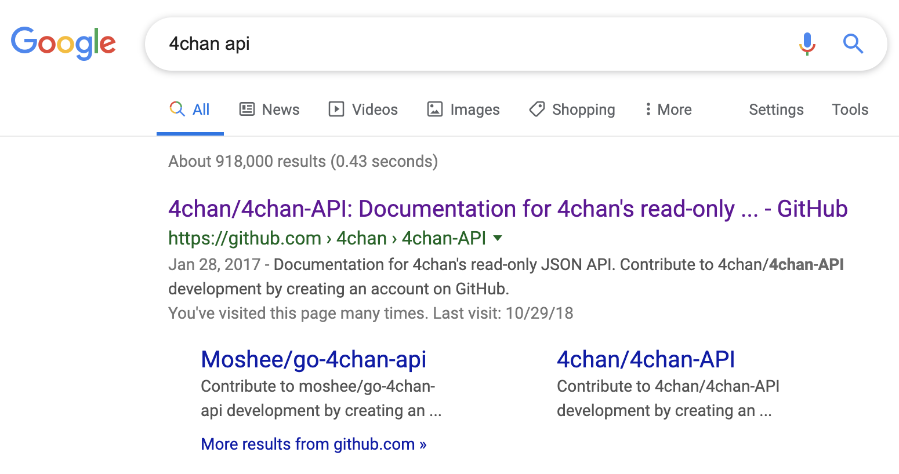
4chan API
How do I know 4chan has an API?!
Google is your friend!

Slide 20
4chan API
Tons of social media platforms have APIs
Many have libraries, or at least a spec

Slide 21
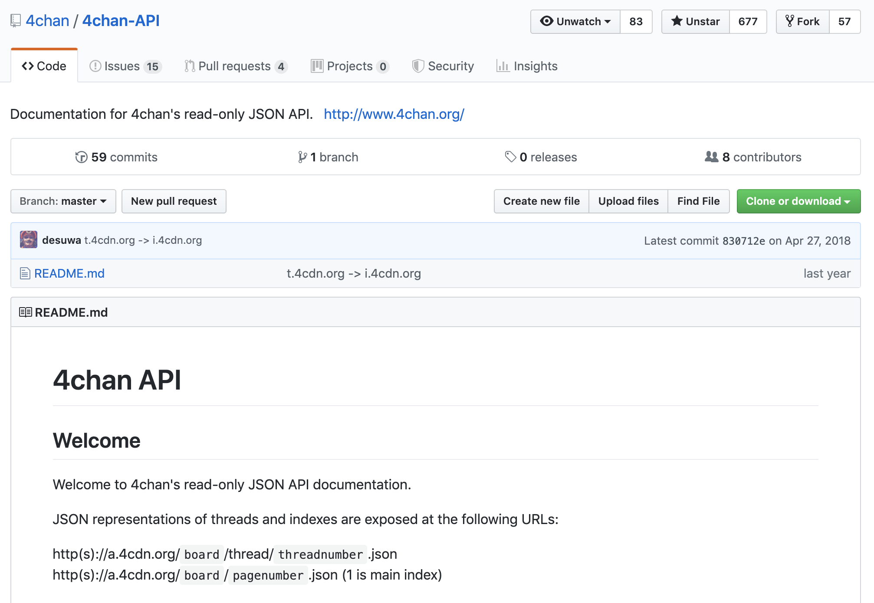
4chan API
Tons of social media platforms have APIs
Many have libraries, or at least a spec

Slide 22
4chan API
Most APIs have rules/terms of service
Very uncommon to find completely open APIs

Slide 23
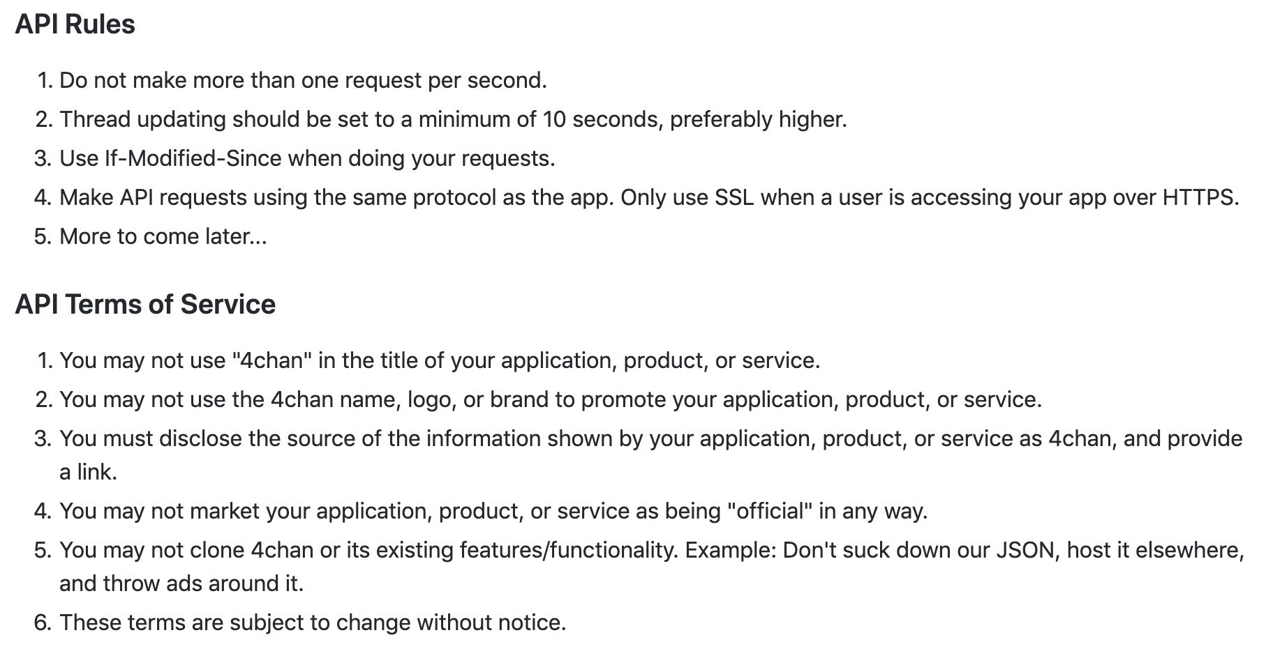
4chan API
Tons of social media platforms have APIs
Many have libraries, or at least a spec

Slide 24
4chan API
Do we care about API rules or Terms of Service?!?
Tons of social media platforms have APIs
Many have libraries, or at least a spec

Slide 25
4chan API
This is a deep discussion
Let’s take a few minutes
Tons of social media platforms have APIs
Many have libraries, or at least a spec

Slide 26
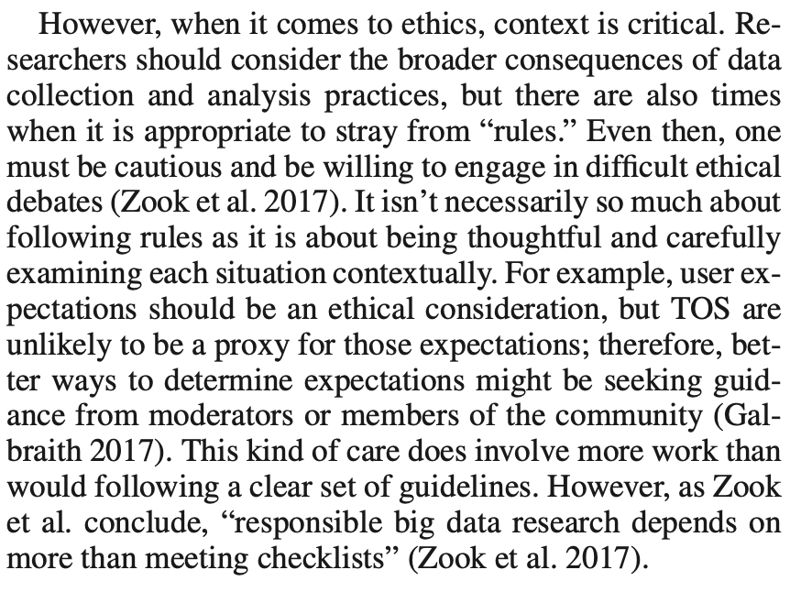
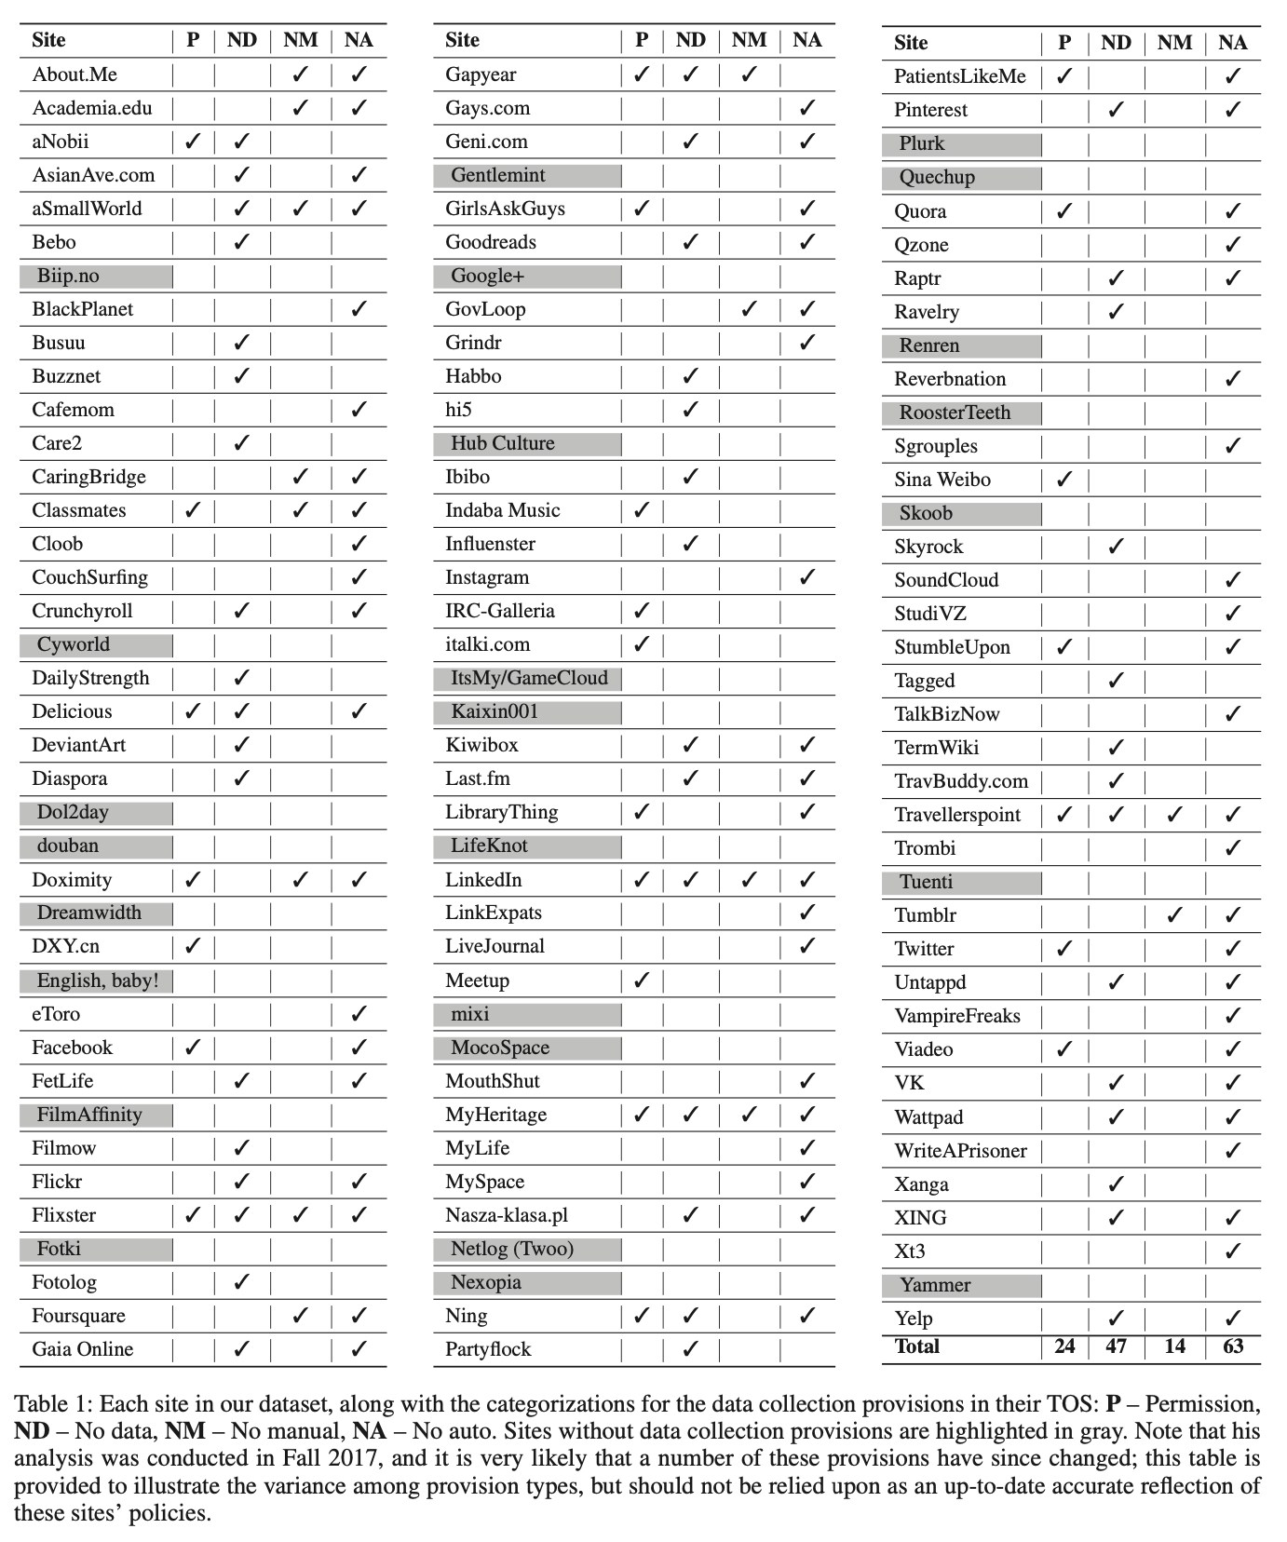
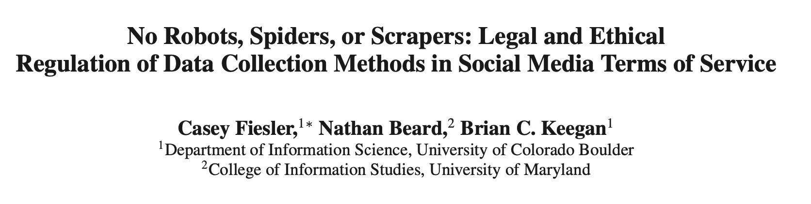

Slide 27
4chan API
It’s a JSON API
Pretty much every decent API will be JSON
Pretty much every programming language will have a JSON library
Checkout https://www.json.org/
JSON is basically just a key/value system
You can nest “Objects”
Let’s you have a very portable, text based, flexible, theoretically human readable data transfer format

Slide 28
4chan API
Let’s take a look at the endpoints
Endpoints are how you access the API

Slide 29
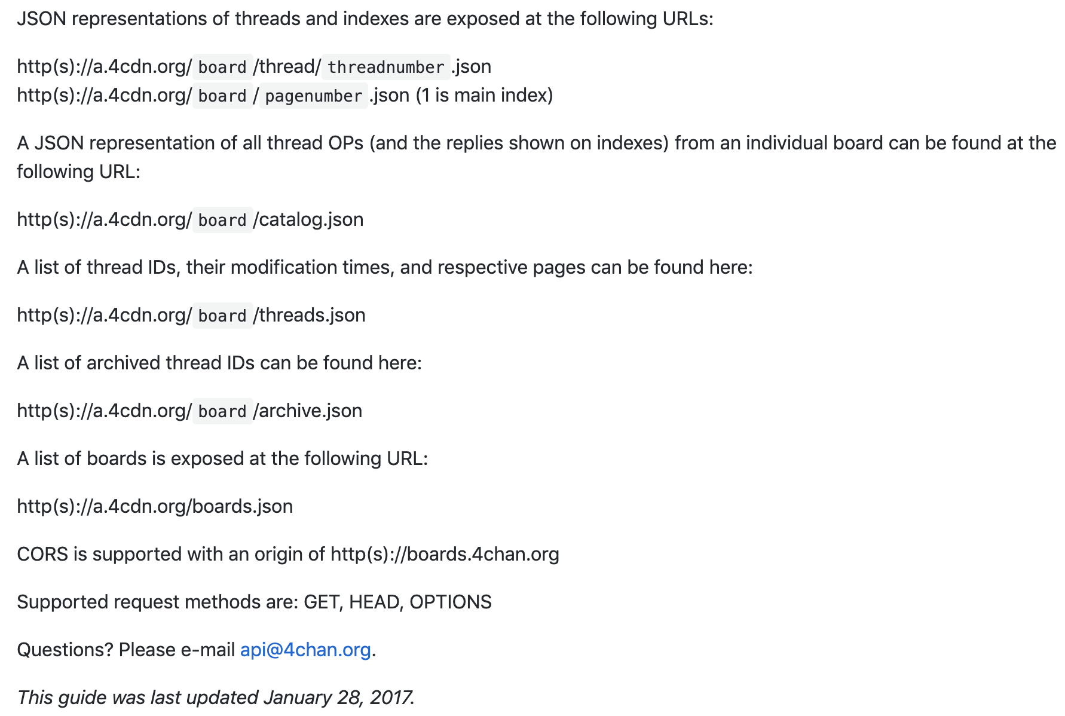
4chan API
Let’s take a look at the endpoints
Endpoints are how you access the API

Slide 30
4chan API
Let’s take a look at the endpoints
Endpoints are how you access the API

Slide 31
4chan API
Let’s take a look at the endpoints
Endpoints are how you access the API

Slide 32
4chan API
Let’s take a look at the endpoints
Endpoints are how you access the API

Slide 33
4chan API
Let’s take a look at the endpoints
Endpoints are how you access the API

Slide 34
4chan API
Let’s take a look at the endpoints
Endpoints are how you access the API

Slide 35
4chan API
Ok, what gets returned?
JSON Objects

Slide 36
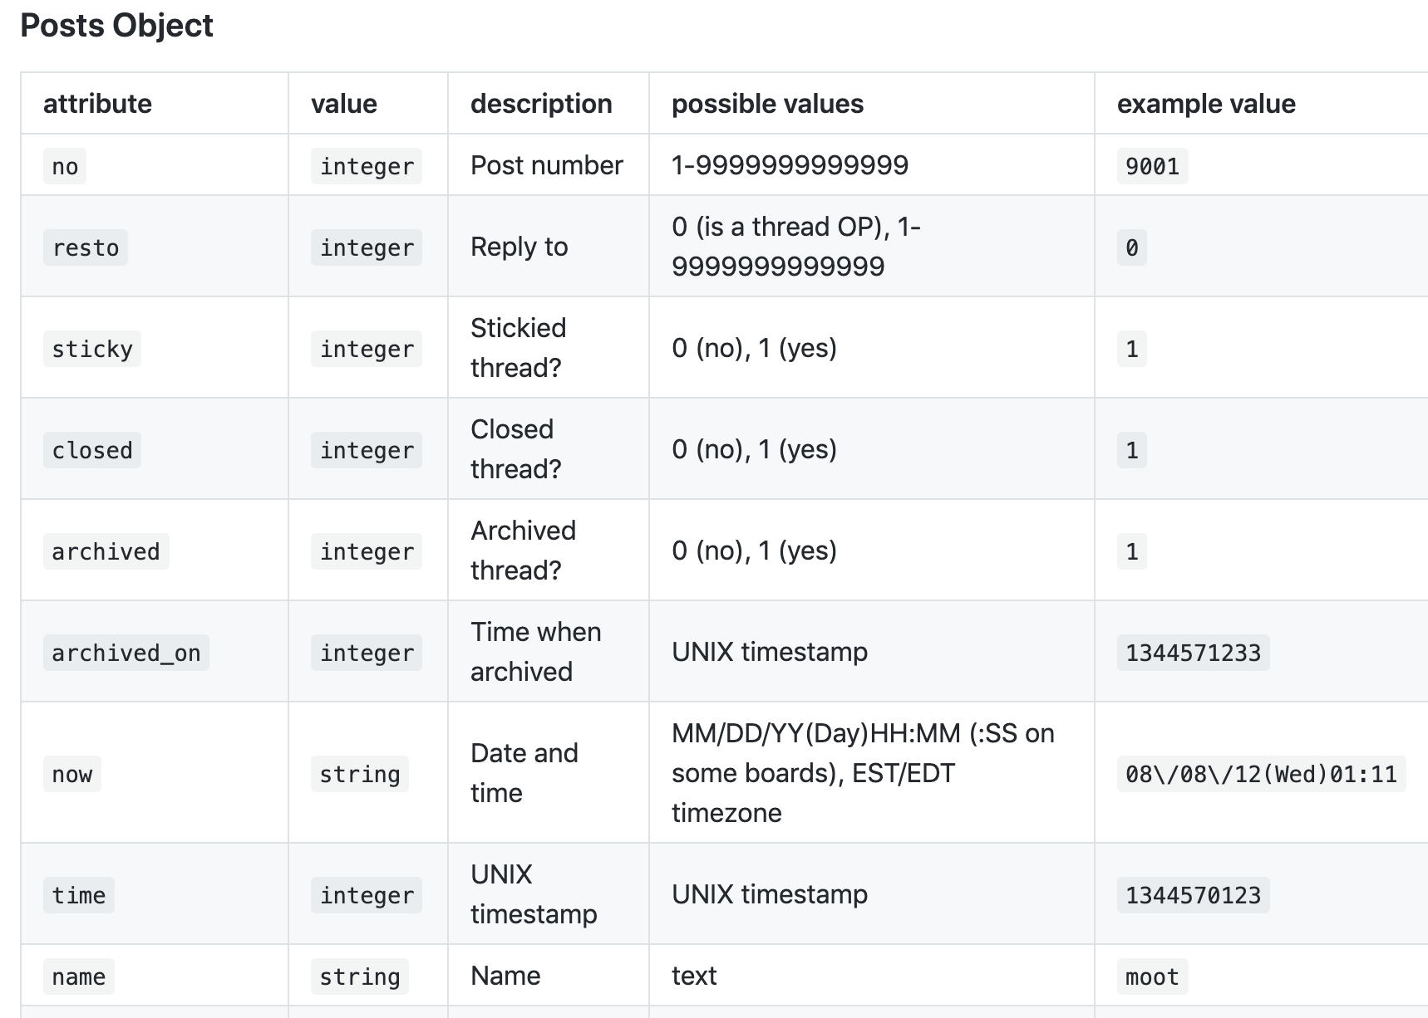
4chan API
Ok, what gets returned?
JSON Objects

Slide 37
4chan API
A bunch of other stuff too!
Ok, what gets returned?
JSON Objects

Slide 38
How Should Our Crawler Operate?
4chan data is ephemeral
We have to figure out a way to make sure we get it before it disappears
4chan does not have a straight forward way to get only new posts
Additional concern with respect to the content that might be posted
We want to do our best to avoid illegal content

Slide 39
What Do We Need To Figure Out?
Definitely: When a new thread is created?
Maybe: When a new post is posted?

Slide 40
How Do We Figure Out If New Thread?
We can use the catalog
What if we look at the catalog every certain number of minutes
If we compare the threads that are in the last crawl of the catalog to those that are in the new crawl of the catalog, we can figure out which threads are new
What are potential problems?
If a thread is created and dies between our crawls, we will miss it

Slide 41
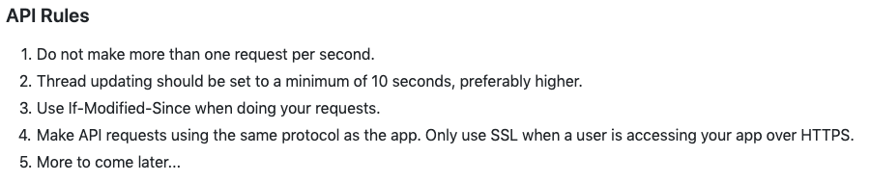
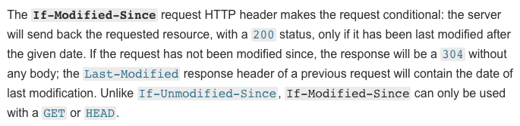
What About Getting Just New Posts?
Not as simple
There is no API call that let’s you get specific posts
We can use the if-modified-since HTTP header

Slide 42
What About Getting Just New Posts?
Not as simple
There is no API call that let’s you get specific threads
We can use the if-modified-since HTTP header

Slide 43
What About Getting Just New Posts?
Problems with this?
4chan just lets us know if a thread has been updated
It doesn’t give us just the updates to the thread
We still have to manually figure out which posts we haven’t stored and then store the new ones

Slide 44
What About Dealing With Illegal Content?
We could crawl threads while they are live
This does expose us to some stuff though
What if some child pornography is posted and we end up storing it before janitors/admins delete it?
With 4chan, there is an archive of threads that have fallen out of the catalog
We can make use of this

Slide 45
What About Dealing With Illegal Content?
Instead of using the catalog to look for new threads, we can look for threads that are not in the catalog when we crawl it, but were in the previous catalog
That means they have been archived
Then just retrieve that thread from the archive!

Slide 46
Building a Client
If we want to do things “right,” we should probably build an API client
This is basically just a wrapper around the Web API that handles a lot of the repetitive stuff
Can handle more or less stuff
Kind of your preference
I like to keep things as simple as possible
Although that is not necessarily easy with certain APIs
As I need more functionality, I add it

Slide 47
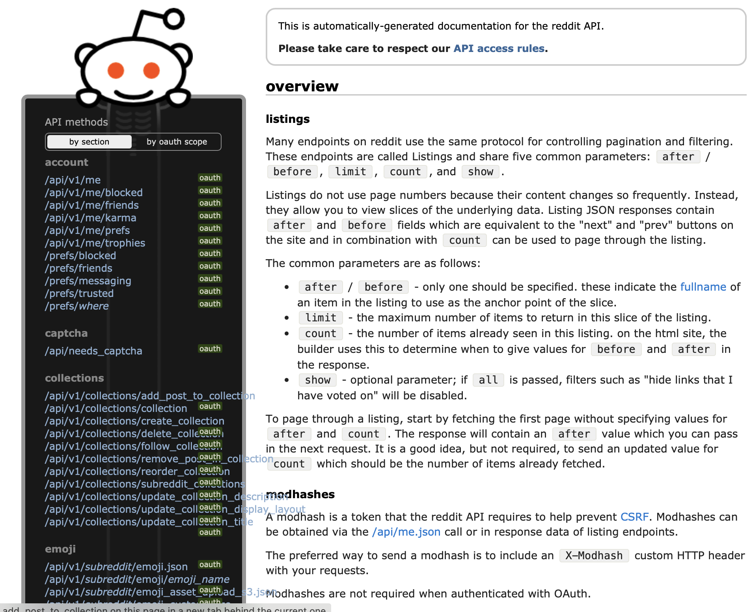
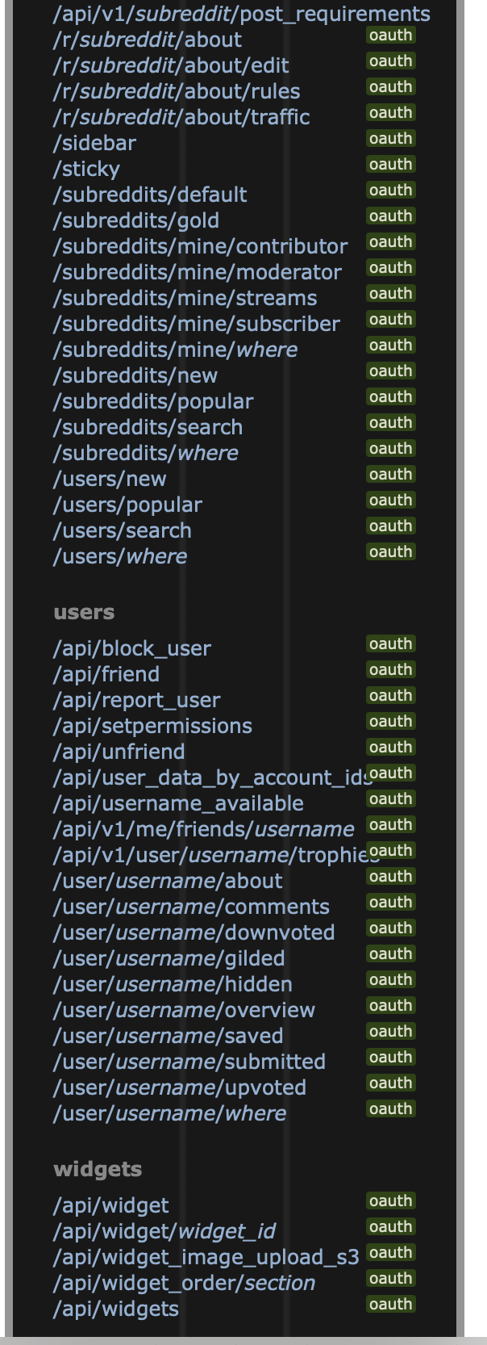
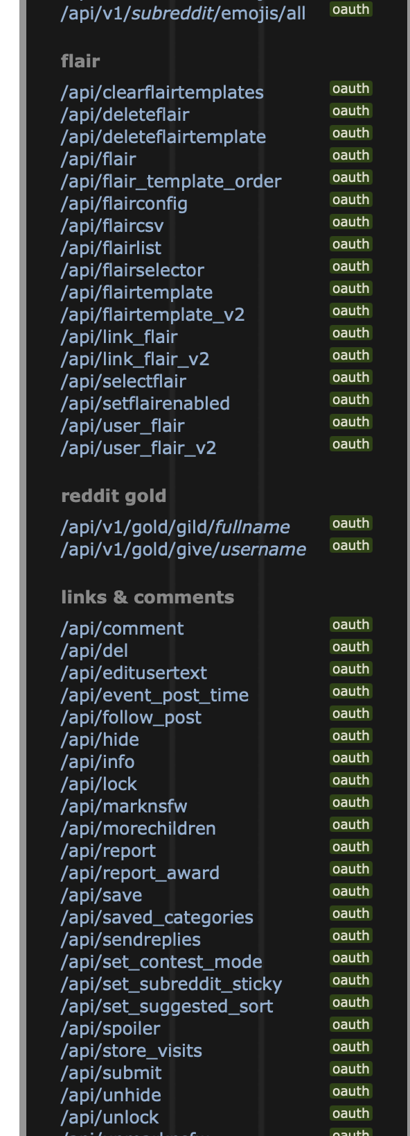
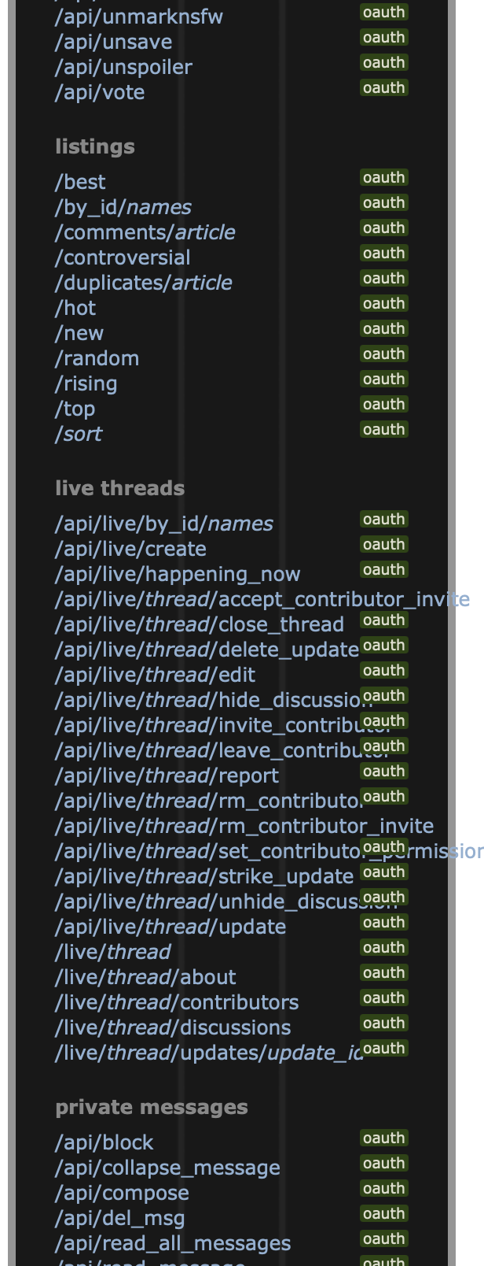
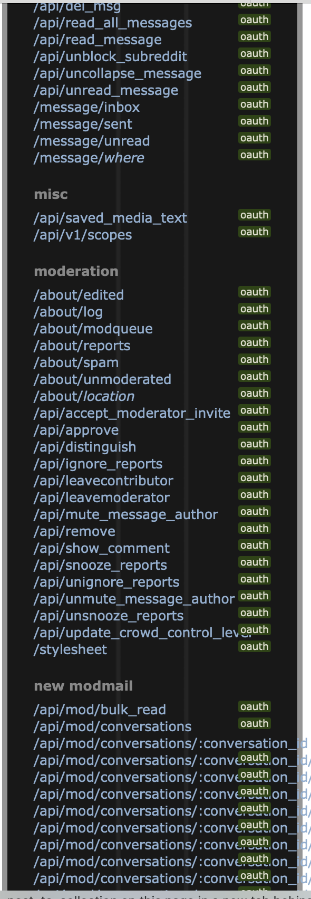
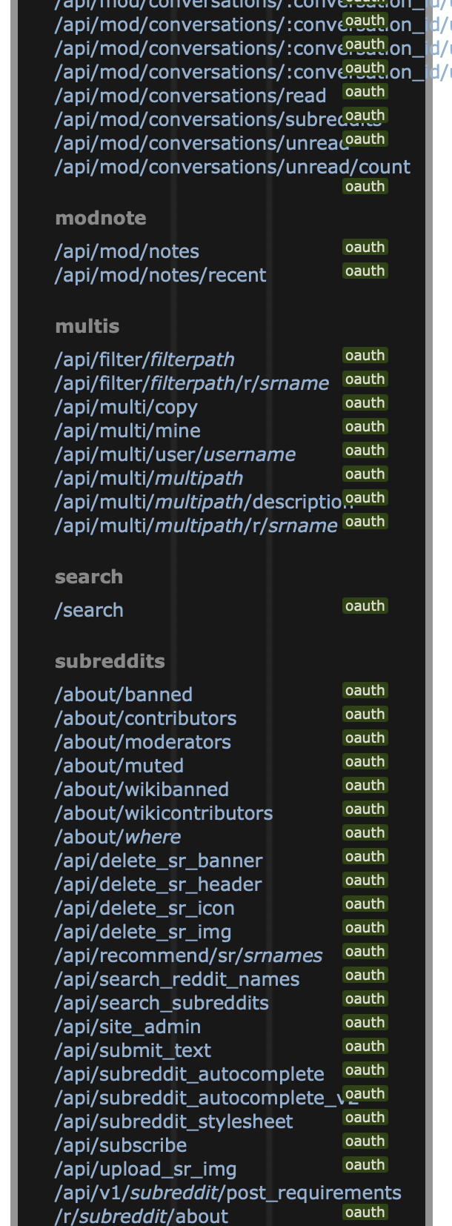
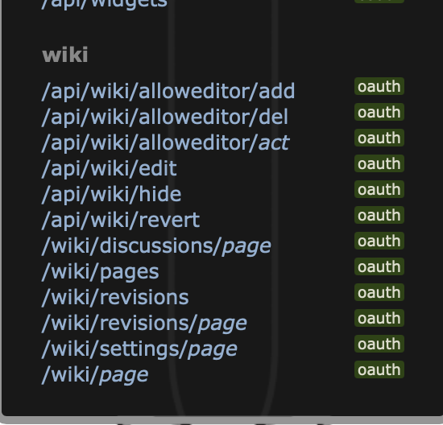
What are we looking for in our client?
Only small chance that we need all the endpoints offered

Slide 48
What are we looking for in our client?
Only small chance that we need all the endpoints offered
We want minimum set of endpoints we need
Usually small subset of all endpoints
We want to focus in on endpoints that let us
Enumerate content
Retrieve content
That’s pretty much it!

Slide 49
4chan API
Let’s take a look at the endpoints
Endpoints are how you access the API

Slide 50
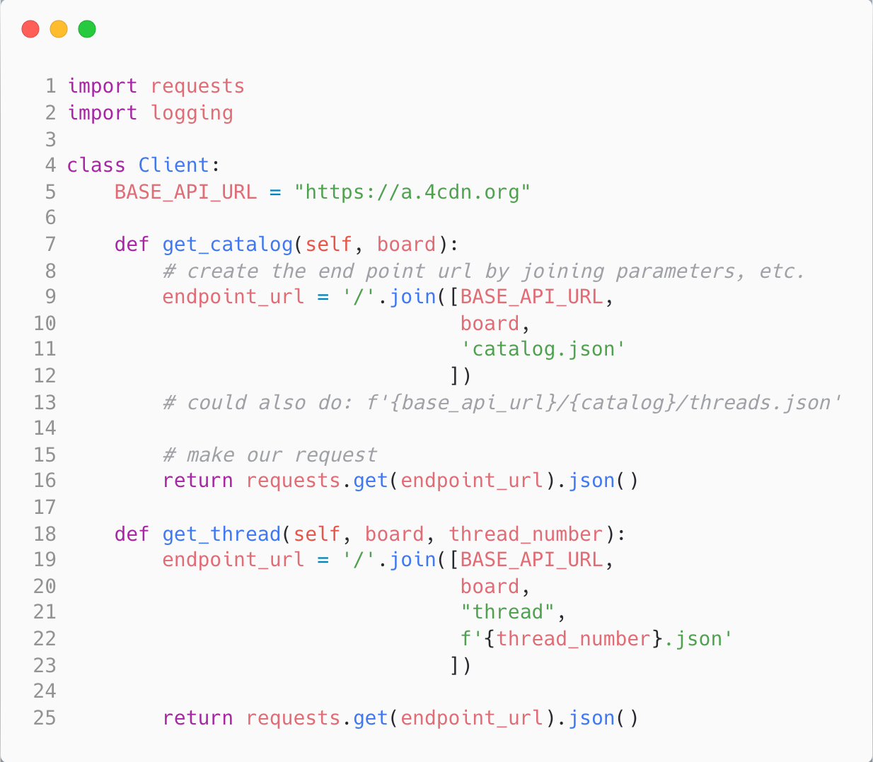

Slide 51
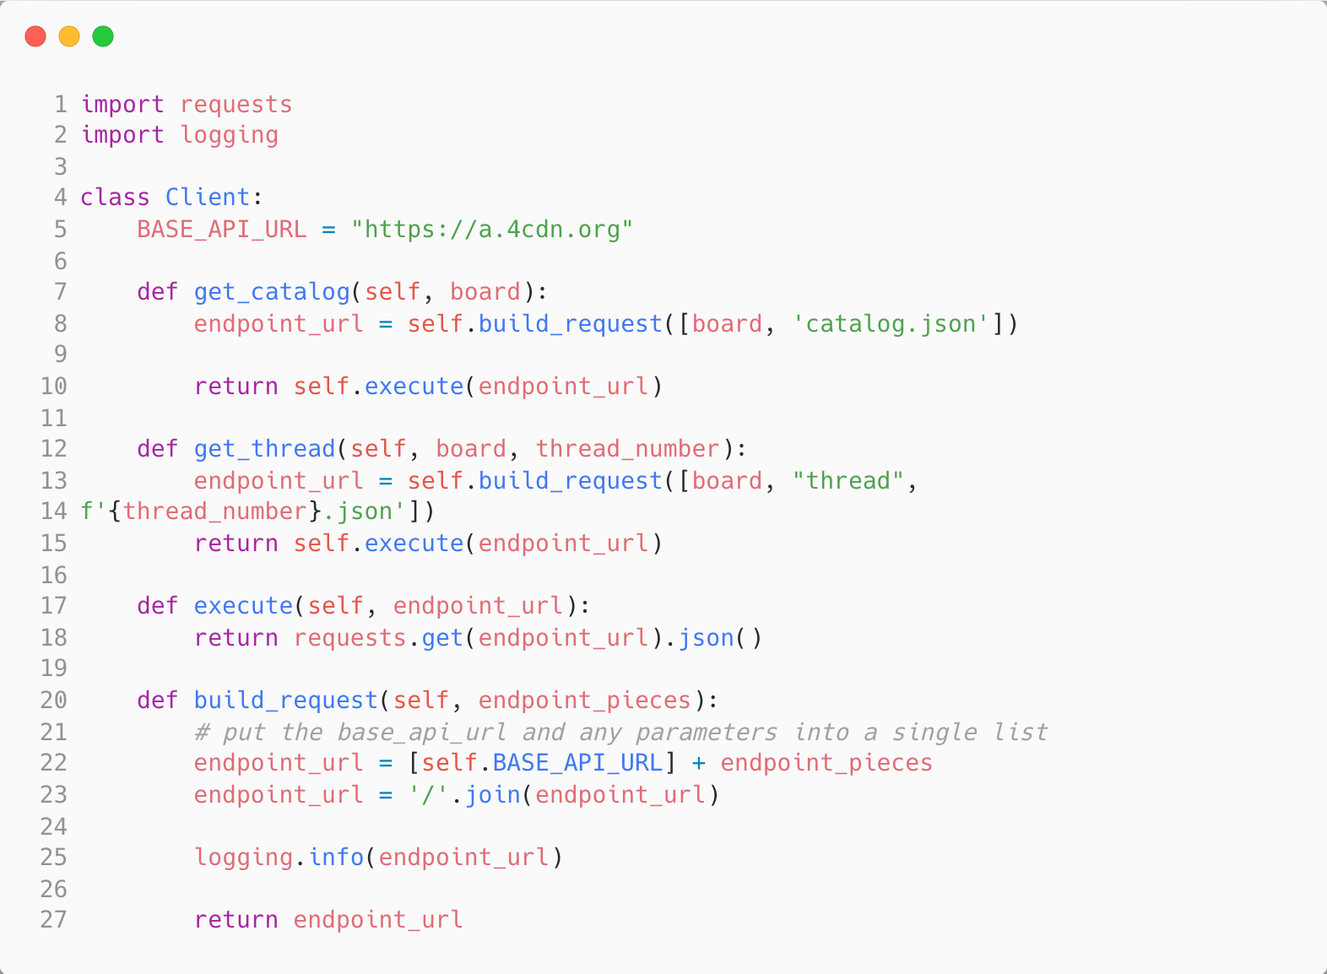
Let’s make things a bit more robust
Can abstract out the code that executes also
(For our simple example, not much point…)
We can abstract out the portion of code that forms the URL

Slide 52
Cool, But, How Do We Control All This?
Personally, I build a crawling pipeline
This is a set of operations that follow one after another
I use a pretty simple job queue system to handle coordination

Slide 53
4chan data is ephemeral
There are some challenges here; we need a strategy
Challenge 1
The API does not provide us with any direct way to request new threads/posts
We could use if-modified-since header, but that doesn’t really solve our problem
Challenge 2
There are timing issues
At minimum we are going to have to run things periodically
Challenge 3
There are various “subtasks” that we need to do
E.g., collect images, maybe do some statistics calculations for live dashboard, etc.
Each of these tasks is bound in different ways (e.g., network IO, DB, CPU, etc.)

Slide 54
4chan data is ephemeral
There are some challenges here; we need a strategy
Challenge 1
The API does not provide us with any direct way to request new threads/posts
We could use if-modified-since header, but that doesn’t really solve our problem
Challenge 2
There are timing issues
At minimum we are going to have to run things periodically
Challenge 3
There are various “subtasks” that we need to do
E.g., collect images, maybe do some statistics calculations for live dashboard, etc.
Each of these tasks is bound in different ways (e.g., network IO, DB, CPU, etc.)

Slide 55
4chan data is ephemeral
There are some challenges here; we need a strategy
Challenge 1
The API does not provide us with any direct way to request new threads/posts
We could use if-modified-since header, but that doesn’t really solve our problem
Challenge 2
There are timing issues
At minimum we are going to have to run things periodically
Challenge 3
There are various “subtasks” that we need to do
E.g., collect images, maybe do some statistics calculations for live dashboard, etc.
Each of these tasks is bound in different ways (e.g., network IO, DB, CPU, etc.)

Slide 56
4chan data is ephemeral
There are some challenges here; we need a strategy
Challenge 1
The API does not provide us with any direct way to request new threads/posts
We could use if-modified-since header, but that doesn’t really solve our problem
Challenge 2
There are timing issues
At minimum we are going to have to run things periodically
Challenge 3
There are various “subtasks” that we need to do
E.g., collect images, maybe do some statistics calculations for live dashboard, etc.
Each of these tasks is bound in different ways (e.g., network IO, DB, CPU, etc.)

Slide 57
4chan data is ephemeral
There are some challenges here; we need a strategy
Challenge 1
The API does not provide us with any direct way to request new threads/posts
We could use if-modified-since header, but that doesn’t really solve our problem
Challenge 2
There are timing issues
At minimum we are going to have to run things periodically
Challenge 3
There are various “subtasks” that we need to do
E.g., collect images, maybe do some statistics calculations for live dashboard, etc.
Each of these tasks is bound in different ways (e.g., network IO, DB, CPU, etc.)

Slide 58
Solution to Challenge 1?
We can periodically collect the Catalog for boards of interest
Compare the threads in Catalog from most recent crawl to the previous crawl
I.e., we do set difference: previous catalog threads – current catalog threads
The set difference is thus the threads that were removed from catalog
I.e., they now live in the Archive
We can then collect the threads from the Archive
This seems kinda like a subtask?

Slide 59
4chan data is ephemeral
There are some challenges here; we need a strategy
Challenge 1
The API does not provide us with any direct way to request new threads/posts
We could use if-modified-since header, but that doesn’t really solve our problem
Challenge 2
There are timing issues
At minimum we are going to have to run things periodically
Challenge 3
There are various “subtasks” that we need to do
E.g., collect images, maybe do some statistics calculations for live dashboard, etc.
Each of these tasks is bound in different ways (e.g., network IO, DB, CPU, etc.)

Slide 60
4chan data is ephemeral
There are some challenges here; we need a strategy
Challenge 1
The API does not provide us with any direct way to request new threads/posts
We could use if-modified-since header, but that doesn’t really solve our problem
Challenge 2
There are timing issues
At minimum we are going to have to run things periodically
Challenge 3
There are various “subtasks” that we need to do
E.g., collect images, maybe do some statistics calculations for live dashboard, etc.
Each of these tasks is bound in different ways (e.g., network IO, DB, CPU, etc.)

Slide 61
4chan data is ephemeral
There are some challenges here; we need a strategy
Challenge 1
The API does not provide us with any direct way to request new threads/posts
We could use if-modified-since header, but that doesn’t really solve our problem
Challenge 2
There are timing issues
At minimum we are going to have to run things periodically
Challenge 3
There are various “subtasks” that we need to do
E.g., collect images, maybe do some statistics calculations for live dashboard, etc.
Each of these tasks is bound in different ways (e.g., network IO, DB, CPU, etc.)

Slide 62
Solution to Challenge 2?
We could use something like cron
Time based job scheduler in Unix systems
What about obeying rate limits?
Cron not really designed for this purpose
What happens if what we do in the cron job doesn’t finish in time?
I.e., it doesn’t finish before the next scheduled run time?
This could happen depending on what subtasks need to be execute…

Slide 63
4chan data is ephemeral
There are some challenges here; we need a strategy
Challenge 1
The API does not provide us with any direct way to request new threads/posts
We could use if-modified-since header, but that doesn’t really solve our problem
Challenge 2
There are timing issues
At minimum we are going to have to run things periodically
Challenge 3
There are various “subtasks” that we need to do
E.g., collect images, maybe do some statistics calculations for live dashboard, etc.
Each of these tasks is bound in different ways (e.g., network IO, DB, CPU, etc.)

Slide 64
4chan data is ephemeral
There are some challenges here; we need a strategy
Challenge 1
The API does not provide us with any direct way to request new threads/posts
We could use if-modified-since header, but that doesn’t really solve our problem
Challenge 2
There are timing issues
At minimum we are going to have to run things periodically
Challenge 3
There are various “subtasks” that we need to do
E.g., collect images, maybe do some statistics calculations for live dashboard, etc.
Each of these tasks is bound in different ways (e.g., network IO, DB, CPU, etc.)

Slide 65
4chan data is ephemeral
There are some challenges here; we need a strategy
Challenge 1
The API does not provide us with any direct way to request new threads/posts
We could use if-modified-since header, but that doesn’t really solve our problem
Challenge 2
There are timing issues
At minimum we are going to have to run things periodically
Challenge 3
There are various “subtasks” that we need to do
E.g., collect images, maybe do some statistics calculations for live dashboard, etc.
Each of these tasks is bound in different ways (e.g., network IO, DB, CPU, etc.)

Slide 66
4chan data is ephemeral
There are some challenges here; we need a strategy
Challenge 1
The API does not provide us with any direct way to request new threads/posts
We could use if-modified-since header, but that doesn’t really solve our problem
Challenge 2
There are timing issues
At minimum we are going to have to run things periodically
Challenge 3
There are various “subtasks” that we need to do
E.g., collect images, maybe do some statistics calculations for live dashboard, etc.
Each of these tasks is bound in different ways (e.g., network IO, DB, CPU, etc.)

Slide 67
Solution to Challenge 3?
When computer scientists hear “subtask” what might we think?
Threads
Can get kinda difficult…
Multiprocessing
Can be inefficient if done incorrectly (but usually better overall in my experience)
Producer/Consumer?
Can we model as producer/consumer?
Retrieve Catalog from 4chan API
For each thread that has been archived
Produce a “collect thread” job and place it into a queue
Have workers (consumers) pull job off queue and execute it
This is also known as a job queuing/processing system
Also lots of other names :D

Slide 68
Job Queues
Pretty simple idea
Producers → Put a job on a queue
Workers → Pull a job off the queue and do the work

Slide 69
Solution to Challenge 3?
Usually, when computer scientists hear “subtask” they say?
Threads
Can get kinda difficult…
Multiprocessing
Can be inefficient if done incorrectly (but usually better overall in my experience)
Producer/Consumer?
Can we model as producer/consumer?
Retrieve Catalog from 4chan API
For each thread that has been archived
Produce a “collect thread” job and place it into a queue
Have workers (consumers) pull job off queue and execute it
This is also known as a job queuing/processing system
Also lots of other names :D

Slide 71
Our job queuing system will let us specify a certain number of worker processes. Sometimes they will let you scale this up dynamically etc.
Bottom line, there is some pool of workers that are going to execute jobs placed into the job queue

Slide 72
We will define various jobs that do different things
E.g., Periodically retrieve (and store) the Catalog for the Boards we are interested in collecting

Slide 73
The CatalogCrawler job retrieves the Catalog, stores it in our DB, and then launches a new job: A CatalogToThreadDeterminer

Slide 74
{
job_id: UUID,
job_type: “CatalogToThreadDeterminer”,
params: {catalog_crawl_id: ID }
}

Slide 75
CatalogCrawler also schedules another CatalogCrawler job to be run in 5 minutes
Facilitated by our Job Queue System

Slide 76
It can also launch additional jobs, e.g., a job that computes some statistics for a real time dashboard

Slide 77
Once the CatalogCrawler job has finished executing, the worker that was executing it pulls the next job out of the Job Queue and executes it.

Slide 78
{
job_id: UUID,
job_type: “CatalogToThreadDeterminer”,
params: {catalog_crawl_id: ID }
}

Slide 79
A worker pulls the ”CatalogToThreadDeterminer” job out of the queue, and executes it
{
job_id: UUID,
job_type: “CatalogToThreadDeterminer”,
params: {catalog_crawl_id: ID }
}

Slide 80
A worker pulls the ”CatalogToThreadDeterminer” job out of the queue, and executes it
Recall that the CatalogToThreadDeterminer is the job that computes the set differences so we know which threads we need to retrieve from the archive

Slide 81
CatalogToThreadDeterminer will put a new ThreadCrawler job in the Queue

Slide 82
A single CatalogToThreadDeterminer can produce many ThreadCrawler jobs!
CatalogToThreadDeterminer will put a new ThreadCrawler job in the Queue

Slide 83
ThreadCrawler Jobs go out and retrieve threads from the API and save to DB
We want images too, so each ThreadCrawler will launch an additional job that will figure out what images we need to retrieve

Slide 84
ThreadImageCrawler figures out which images we need to download. The JSON representation of a Post includes some fields that we can use to determine:
if the post included an image
2) the URL to retrieve that image

Slide 85
For each image URL discovered, a new ImageRetriever Job will be placed in the job queue system

Slide 86
ImageRetrievers go out and retrieve the actual image
Note that this is relatively time consuming. Images tend to be much larger than text!

Slide 87
So why is this a pipeline?

Slide 88
There is a clear ordering of things going on

Slide 98
Statistics from Catalog (e.g., new threads per minute?)

Slide 99
Statistics from Catalog (e.g., new threads per minute?)
Statistics from Threads (e.g., new threads per minute?)

Slide 100
Scheduling Jobs
We want to have a pipeline
Jobs do something, then data is moved forward to other stages of the pipeline
NB: Our pipeline doesn’t have to be straight! It can have branches, etc.
Ordering of stages is relatively simple
Scheduling less so
We will use Faktory, an open source, language agnostic, job scheduling system
https://github.com/contribsys/faktory
Read the documentation!!!!

Slide 101
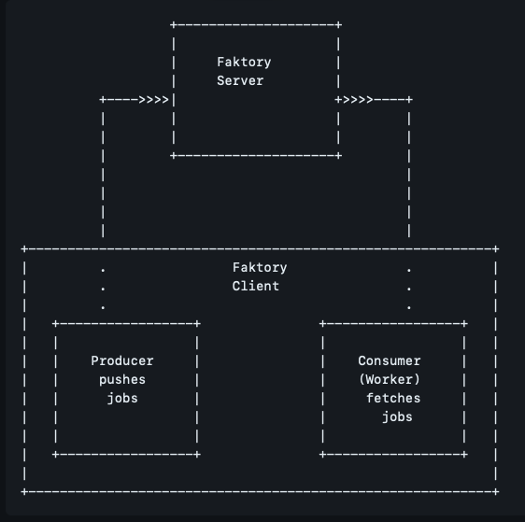

Slide 102
Wait, How Are We Going to Store this Stuff?
Any ideas?
Files?
RDBMS?
NoSQL database?

Slide 103
Wait, How Are We Going to Store this Stuff?
Any ideas?
Files?
RDBMS?
NoSQL database?

Slide 104
Wait, How Are We Going to Store this Stuff?
Any ideas?
Files?
RDBMS?
NoSQL database?

Slide 105
Wait, How Are We Going to Store this Stuff?
Any ideas?
Files?
RDBMS?
NoSQL database?

Slide 106
Storing Files
Pros?
Easy
Mostly straight forward
Cons?
Can’t really search it; hard to do random access
Need to keep track of the files
Might run into File System limitations/issues

Slide 107
Relational Database Management System
RDBMS
SQL database
Postgres
MySQL
MS-SQL Server
Oracle
Pros?
Lots of features
Cons?
Scaling/normalization?

Slide 108
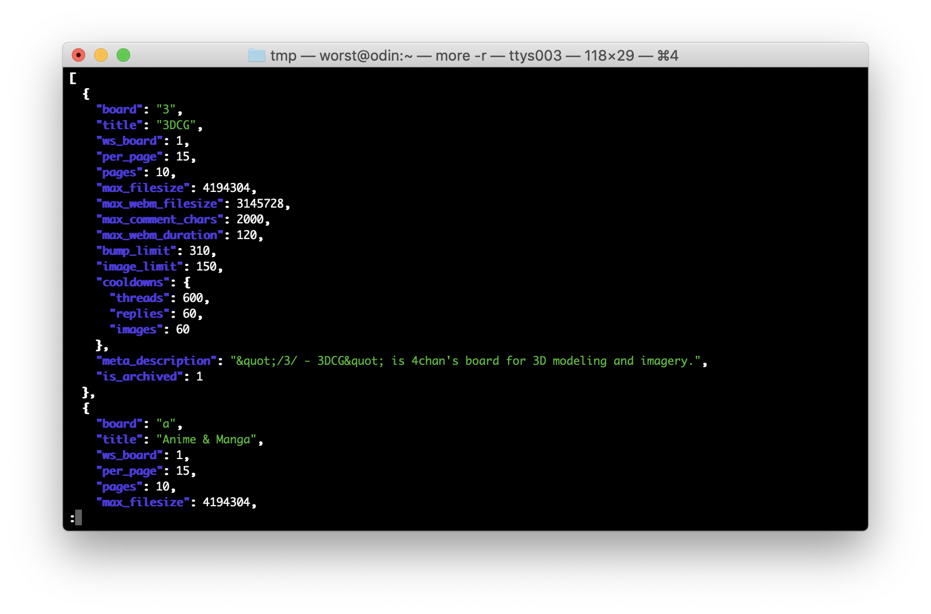

Slide 109
Let’s Think About This…
We have a list of boards
Represented as JSON objects
Each object has some keys and values
We can normalize this
I.e., breaking things up as tabular data

Slide 110
Let’s Think About This…
We have a board name
A board title
A bump limit
The max number of pages
Other stuff too…

Slide 111
Tabular Data
We can view board objects as tabular data by treating data item as a row
Each key in the JSON object can be a column in a row
board | title | bump_limit | num_pages

Slide 112
Tabular Data
We can view board objects as tabular data by treating data item as a row
Each key in the JSON object can be a column in a row
board | title | bump_limit | num_pages
“3” | “3DCG“ | 310 | 10

Slide 113
Tabular Data
We can view board objects as tabular data by treating data item as a row
Each key in the JSON object can be a column in a row
board | title | bump_limit | num_pages
“3” | “3DCG“ | 310 | 10
“a” | “Anime & Manga“ | 500 | 10

Slide 114
Tabular Data
We can view board objects as tabular data by treating data item as a row
Each key in the JSON object can be a column in a row
board | title | bump_limit | num_pages
“3” | “3DCG“ | 310 | 10
“a” | “Anime & Manga“ | 500 | 10
Can anyone see any issues with this approach?

Slide 115
Tabular Data
We can view board objects as tabular data by treating data item as a row
Each key in the JSON object can be a column in a row
board | title | bump_limit | num_pages
“3” | “3DCG“ | 310 | 10
“a” | “Anime & Manga“ | 500 | 10
What about fields that don’t map easily to columns?
What happens if the output of the API changes?
What kind of effort is needed to create and maintain the tabular mapping?

Slide 116
Tabular Data
We can view board objects as tabular data by treating data item as a row
Each key in the JSON object can be a column in a row
board | title | bump_limit | num_pages
“3” | “3DCG“ | 310 | 10
“a” | “Anime & Manga“ | 500 | 10
What about fields that don’t map easily to columns?
What happens if the output of the API changes?
What kind of effort is needed to create and maintain the tabular mapping?

Slide 117
Tabular Data
We can view board objects as tabular data by treating data item as a row
Each key in the JSON object can be a column in a row
board | title | bump_limit | num_pages
“3” | “3DCG“ | 310 | 10
“a” | “Anime & Manga“ | 500 | 10
What about fields that don’t map easily to columns?
What happens if the output of the API changes?
What kind of effort is needed to create and maintain the tabular mapping?

Slide 118
We are going to use Postgres
Using other things (e.g., MongoDB) is fine
I don’t use it because of some bad experiences in the past
Postgres has tons of plugins etc. that work well for me
We are not going to use an Object Relational Mapping system
ORMs give you a higher level abstraction
They make sense for a lot of applications, but not ours
We will use pure sql with a few helpers
Mostly something to help with migrations

Slide 119
DB Migrations
Data collection system is not super complex, but it is an application
We have some bits of “business logic”
We also want to be able to do some analyses at some point
Sometimes (often) it’s not entirely clear what we need at beginning
I’m rarely right the first time I model data
Convenience
It’s a pain in the ass to manage schemas directly
Migration
Let’s us apply, in an ordered fashion, arbitrary sql statements

Slide 120
Tools
Lots of them
The good ones are language independent
“migrate” (written in go)
https://github.com/golang-migrate/migrate
“sqlx” (written in rust)
https://github.com/launchbadge/sqlx
There other
Why sqlx?
I use it ☺
I have fundamental issues with go and don’t like it as a language ☺

Slide 121
sqlx-cli
sqlx is a bigger database library, but there is a cli as well
https://github.com/launchbadge/sqlx/blob/main/sqlx-cli/README.md
We will use it to handle our migrations
Idk the most straight forward way to install if you don’t have rust
I’ll try to find something
We also need to have a DB installed
I have timescaledb installed on my system
Via docker
Notes for installation will be sent out

Slide 122
Environment variables
Lots of configuration of applications is via environment variables
Vs. config files
Can be more easily secured
Easier to ensure they are kept out of source control!
Can be easily changed via a variety of other deployment mechanisms
Lots of programs will read from a .env file
This makes local development a lot easier
Unix shells
VARIABLE_NAME_=whatever ./program-to-run
Powershell
???
DATABASE_URL=<connection string>

Slide 123
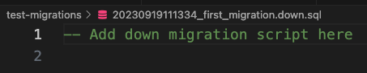
Creating a migration
sqlx migrate add -r --source /path/you/want/migrations ”some name”
-r → reversable (there will be an up and down migration)
--source → if you want your migrations to be in a specific directory
The migration is just a sql script

Slide 124
